Slide 1
VarScan 2: Somatic mutation and copy number alteration discovery in cancer by exome sequencing
Algorithm to compare normal and tumor samples and identify significant differences:
copy number alterations (CNAs)
somatic mutations

Slide 2
VarScan 2
The algorithm reads data from both samples simultaneously
(tumor – normal pairs)
Input data comes from exon sequencing
Heuristic and statistical methods

Slide 3
Exome sequencing
Two steps:
Select subset of DNA that encodes proteins (exons).
2nd step is to sequence the exonic DNA using any high-throughput DNA sequencing technology.
The goal of this approach is to identify genetic variants that alter protein sequences

Slide 4
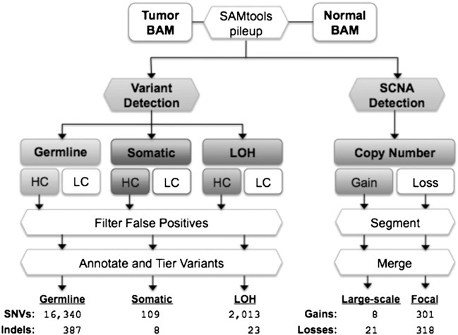
VarScan 2 algorithm
SCNA: somatic copy number alterations
HC: high confidence
LC: low confidence
LOH: loss of Heterozygozity
SNVs: single nucleotide variants
Notes:
Large scale: > 25% of chromosome arm

Slide 5
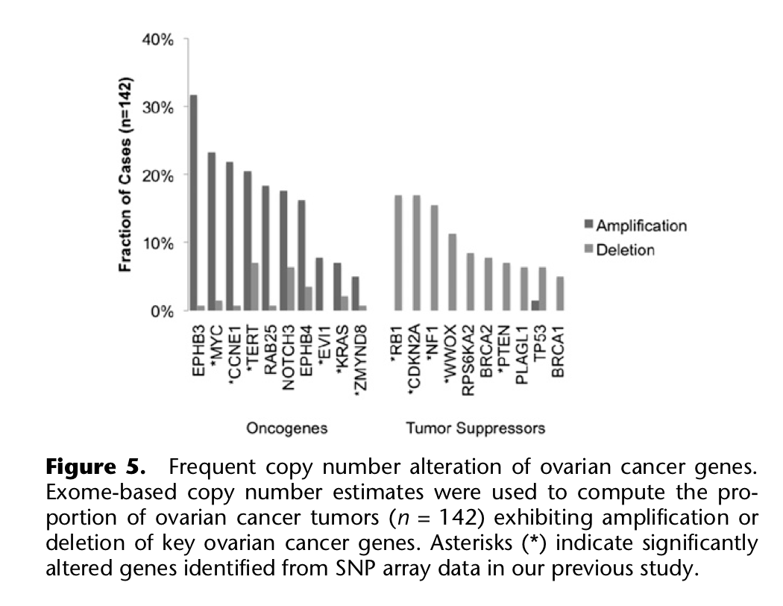
Results

Slide 6
Discussion
Simultaneous identification
Somatic mutation detection:
similar sensitivity, higher true- positive rate compared with more simplistic approaches
removes the vast majority of false positives while preserving sensitivity for true mutation
Rapid screening of coding regions or somatic alterations by exome sequencing
But:
Misses larger events that cannot spanned by single reads

Slide 7
Questions/Discussion
Notes:
WGS is required to identify the full spectrum of somatic alterations in tumor genomes
Loss of heterozygosity

